Slide 1
Food Labelling
For The Blind
MEMBERS:
RAAGHASHREE M (RA2211030010040)
RITHIKA BALAJI (RA2211030010058)
CHITHRESH A (RA2211030010073)

Slide 2
Individuals who are blind or visually impaired face significant challenges when it comes to accessing and understanding the information presented on food product labels. Traditional methods of reading such labels, which rely on visual cues, are inaccessible to these individuals, leading to difficulties in making informed dietary choices. As a result, they may struggle to identify allergens, nutritional content, and other critical information, putting their health and well-being at risk.

Slide 3
solution?
Device/Application that utilizes advanced image recognition and text-to-speech technology to provide real-time assistance for individuals who are blind or visually impaired when reading food product labels.
It analyzes images of labels, accurately extracts the text , including ingredient lists, nutritional information, and allergen warnings.
This text is then converted into spoken words, allowing users to hear the contents of the label read aloud, thereby enabling them to make informed dietary choices independently.
This solution enhances accessibility and empowers individuals with visual impairments to navigate the complexities of food labeling with ease and confidence.

Slide 4
How does it work?
Text Recognition:
OCR (Optical Character Recognition) Datasets: These datasets consist of images with associated text annotations. They are used to train models to recognize and extract text from images
Labeled Text Datasets: Datasets containing labeled text data can be used for tasks such as named entity recognition, sentiment analysis, and language translation. Examples include the Reuters dataset, IMDB dataset, and various datasets available through platforms like Kaggle and OpenAI.
Speech Synthesis (Text-to-Speech):
Speech Corpora: These datasets consist of audio recordings along with their corresponding text transcriptions. They are used to train text-to-speech (TTS) models. Examples include the LJSpeech dataset, LibriSpeech dataset, and Mozilla Common Voice dataset

Slide 5
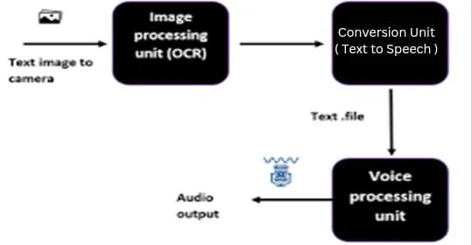

Slide 6
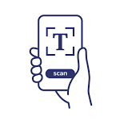
Developing a model
Application that aims to enable users to scan product labels using the device's camera, extract text from the captured images, and convert the text into audio output for auditory consumption.
Process:
Image Acquisition and Processing (OpenCV)
Text Extraction (PyTesseract)
Text-to-Speech Conversion (pyttsx 3 and gTTS)
Accessible User Interface:

Slide 7
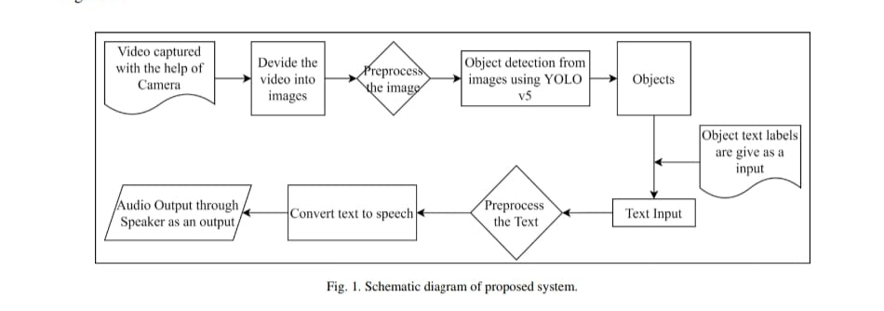
Schematic Diagram

Slide 8
Future Advancements
Multi-Language Support: As global accessibility becomes increasingly important, future advancements may include support for multiple languages, allowing users from diverse linguistic backgrounds to benefit from the technology.
Integration with Wearable Devices: Integration with wearable devices, such as smart glasses or headsets, could offer a more seamless and hands-free experience for users. This would enable them to receive real-time audio feedback about label contents without needing to hold a separate device.
Integration with Smart Assistants: Integration with virtual assistants like Siri, Alexa, or Google Assistant could enable seamless interaction with the AI-driven system, allowing users to access label information through voice commands and receive personalized assistance.

Slide 9
Thank you!

